Slide 1


Plant Disease Detection using Convolution Neural Network
Mohammadshoaib Nadaf (1328)
Shruti Thorat(1347)
Prashant Karhale Akshay Tilekar (External Guide)
Center Coordinator Rahul Pund (Internal Guide)
Tejal Mehetre (Internal Guide)
Presented by:

Slide 2
Introduction
PLANT DISEASE DETECTION USING CONVOLUTION NEURAL NETWORK
One of the important sectors of Indian Economy is Agriculture
Since the past days and in the present too, farmers usually detect the crop diseases with their naked eye which makes them take tough decisions on which fertilizers to use.
It requires detailed knowledge the types of diseases and lot of experience needed to make sure the actual disease detection.
Some of the diseases look almost similar to farmers often leaves them confused.

Slide 3
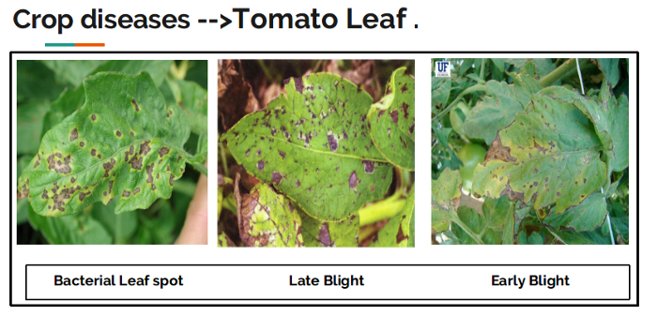
PLANT DISEASE DETECTION USING CONVOLUTION NEURAL NETWORK
Look at the below image for more understanding.
They look the same and almost similar. In case the farmer makes wrong predictions and uses the wrong fertilizers or more than the normal dose (or) threshold or Limit (every plant has some threshold fertilizers spraying to be followed), it will mess up the whole plant (or) soil and cause enough damage to plant and fields.
Institute for Advanced Computing and Software Development, Akurdi

Slide 4
So, How to prevent this from happening?
PLANT DISEASE DETECTION USING CONVOLUTION NEURAL NETWORK
To prevent this situation we need better and perfect guidance on which fertilizers to use, to make the correct identification of diseases, and the ability to distinguish between two or more similar types of diseases in visuals.
This is where Convolution Neural Networks comes handy. In short CNN
Institute for Advanced Computing and Software Development, Akurdi

Slide 5
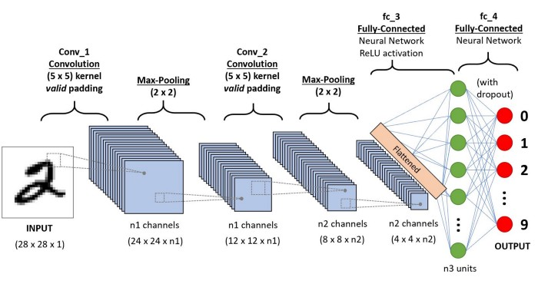
Convolution Neural Network
PLANT DISEASE DETECTION USING CONVOLUTION NEURAL NETWORK
In deep learning, a convolutional neural network is a class of deep neural networks, most commonly applied to analyzing visual imagery. They are also known as shift invariant or space invariant artificial neural networks, based on their shared-weights architecture and translation invariance characteristics.
Institute for Advanced Computing and Software Development, Akurdi

Slide 6
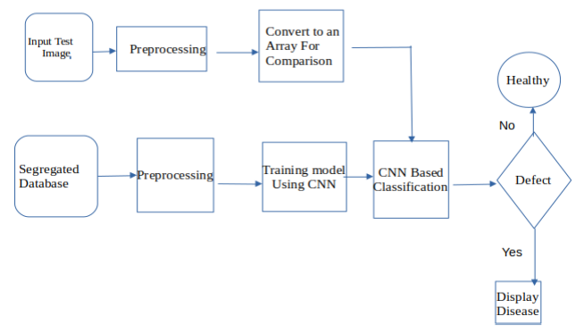
Proposed Methodology
PLANT DISEASE DETECTION USING CONVOLUTION NEURAL NETWORK

Slide 7
Dataset
PLANT DISEASE DETECTION USING CONVOLUTION NEURAL NETWORK
Name | No of Classes | Class Names
Bell Pepper | 02 | Pepper bell Bacterial spot Pepper bell healthy
Potato | 03 | Potato Early blight Potato Late blight Potato Healthy
Tomato | 10 | Bacterial spot Early blight Late blight Leaf Mold Septoria leaf spot Spider mites Target Spot Yellow Leaf Curl Virus Mosaic virus Healthy

Slide 8
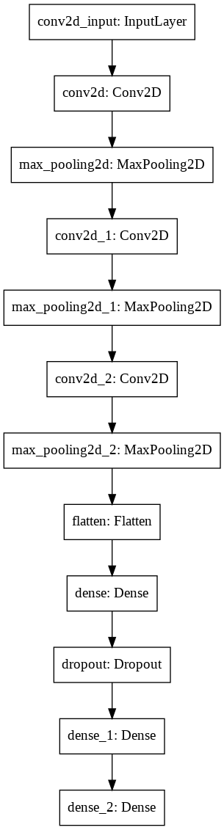
Main Steps to build a CNN (or) Conv. net:
PLANT DISEASE DETECTION USING CONVOLUTION NEURAL NETWORK
Convolution Operation
ReLU Layer (Rectified Linear Unit)
Pooling Layer (Max Pooling)
Flattening
Fully Connected Layer

Slide 9
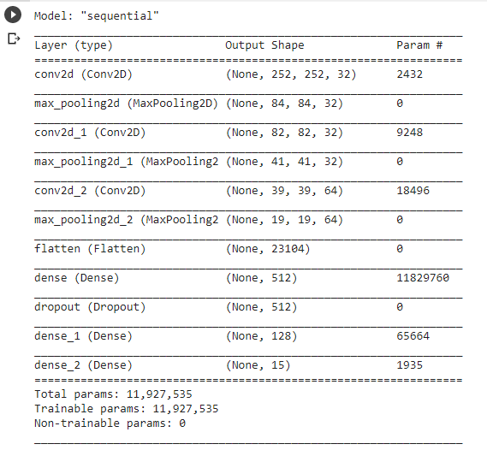
Model Summary
PLANT DISEASE DETECTION USING CONVOLUTION NEURAL NETWORK

Slide 10
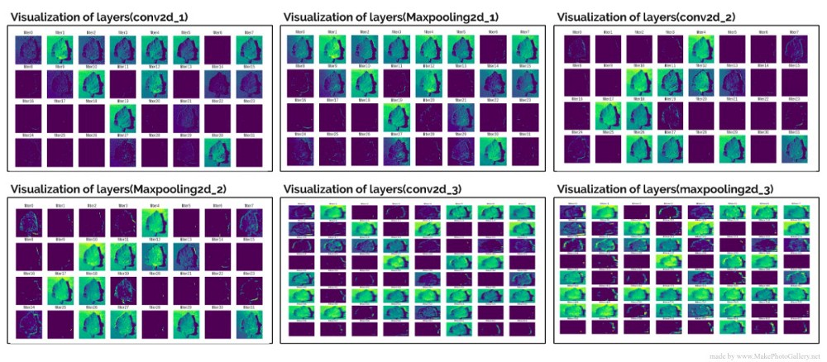
Visualization After Each Layer
PLANT DISEASE DETECTION USING CONVOLUTION NEURAL NETWORK

Slide 11
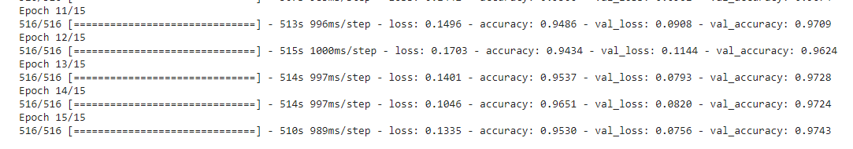
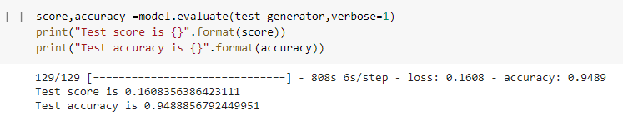
Accuracy
PLANT DISEASE DETECTION USING CONVOLUTION NEURAL NETWORK
Training Accuracy
Testing Accuracy

Slide 12
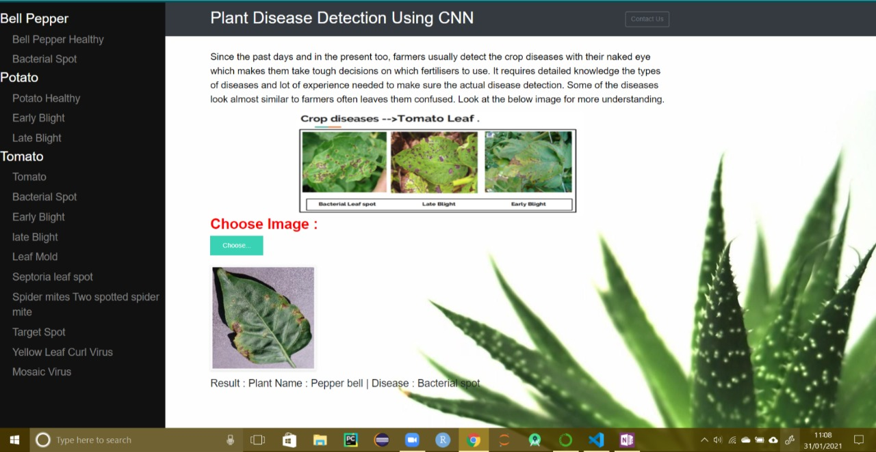
User Interface
PLANT DISEASE DETECTION USING CONVOLUTION NEURAL NETWORK
V

Slide 13
Conclusion :
PLANT DISEASE DETECTION USING CONVOLUTION NEURAL NETWORK
This system has utilized deep learning capabilities to achieve automatic plant disease detection system. This system is based on a simple classification mechanism which exploits the feature extraction functionalities of CNN. For prediction finally, the model utilizes the fully connected layers.
The system has achieved an overall 94% testing accuracy on publically accessible dataset,
It is concluded from accuracy that CNN is highly suitable for automatic detection and diagnosis of plants. This system can be integrated into mini-drones to live detection of diseases from plants in cultivated areas.

Slide 14
Future Aspects
PLANT DISEASE DETECTION USING CONVOLUTION NEURAL NETWORK
Real Time Detection using drones on the green fields
Ordering fertilizer from ecommerce site.
Mobile application for personalized use
Setting reminder for pesticides/watering etc.
Advising on best practices.

Slide 15
Thank You
PLANT DISEASE DETECTION USING CONVOLUTION NEURAL NETWORK

